Slide 1
Group Members:
Elysée NIYIBIZI - 2305000921
Yves BAHATI - 2305000895
Ange HIRWA - 2301001139
Esther NIYOKWIZERWA - 2305000181
Henritte SHIMWA - 23050001684
Kevine Isaro SONGA - 2401000544
Chaste Aime HIRWA - 2305001399
Nelly Gasaro - 2201011337
Aime RUGERO - 2305000797
INES IGIHOZO - 2305001358
Jennifer Nina NZIZA - 2301000526
Elliane MBABAZI - 2301000818
Elie NDAYISENGA - 2301000202
Date: 5 April 2025

Slide 2
Topic.
As an IT, with the features of Multimedia, Describe the use of Multimedia in society and their advantages with disadvantages, how to limit these disadvantages and how we can preserve the multimedia to be used in future of Africa.

Slide 3
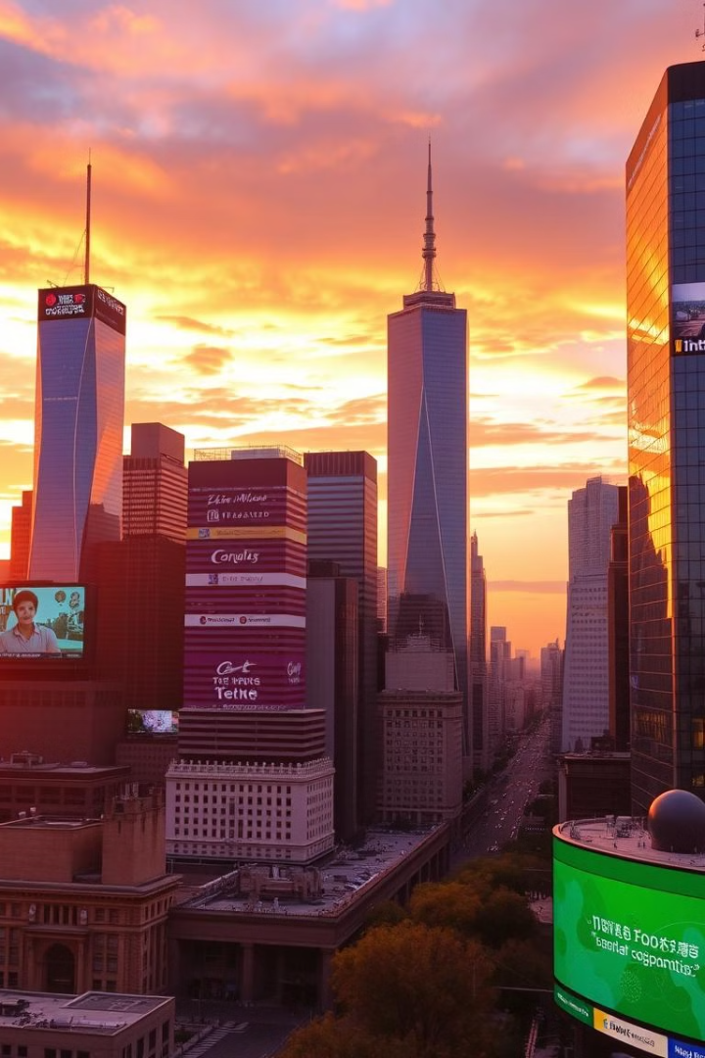
Introduction to Multimedia
Multimedia combines text, audio, video, images, animation, and interactivity.
It is used in education, healthcare, entertainment, business, and government.

Slide 4
Multimedia in Society
Education
Healthcare
Entertainment
E-learning platforms
Training simulations
Music
Virtual labs
Telemedicine
Movies
Interactive content
Awareness campaigns
Video games
Social media

Slide 5
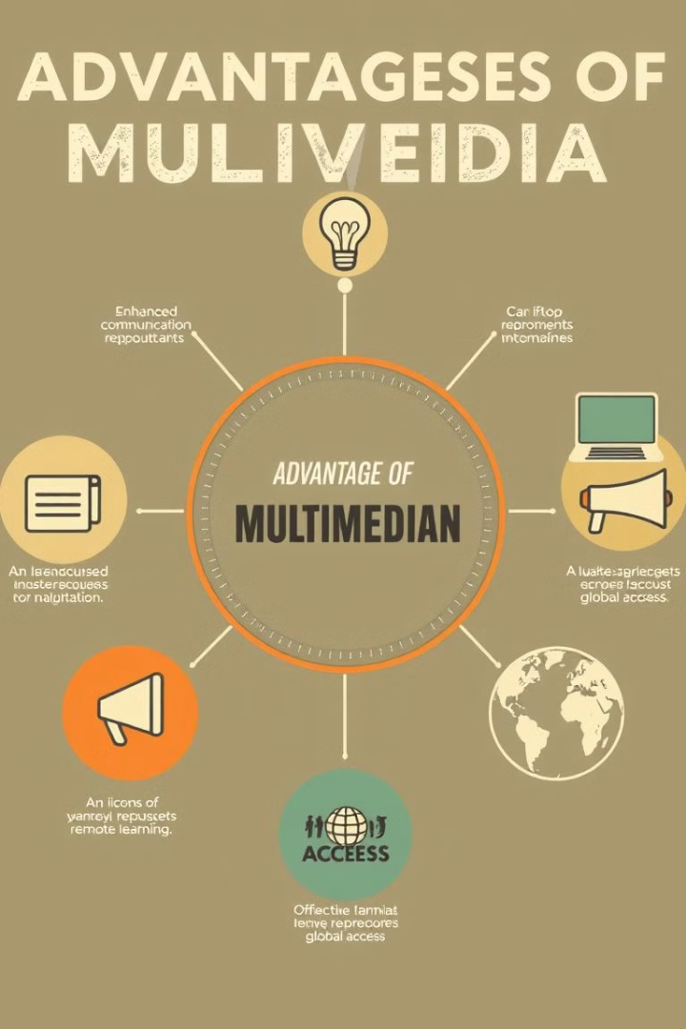
Advantages of Multimedia
Communication
Engagement
Enhances communication and understanding.
Encourages creativity and engagement.
Accessibility
Supports remote learning and work.

Slide 6
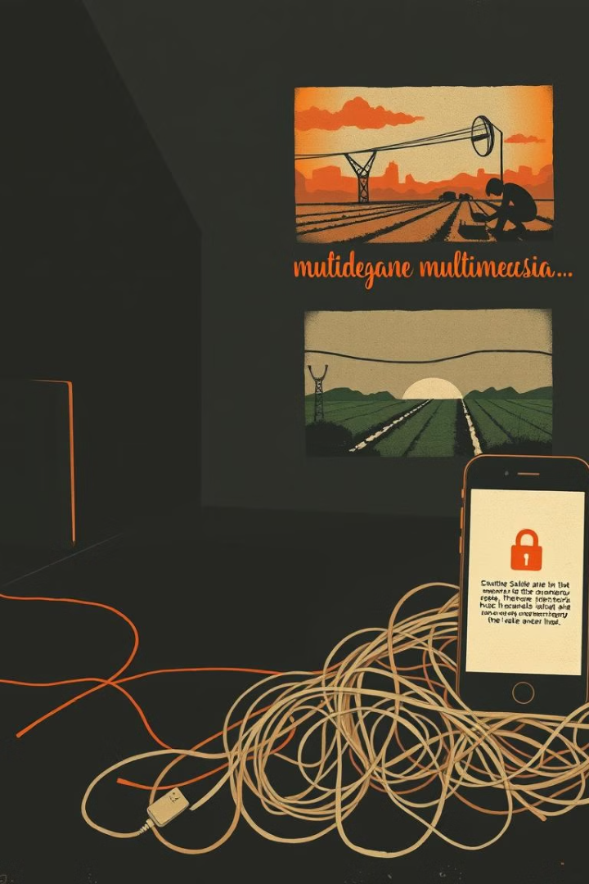
Disadvantages of Multimedia
Addiction
Digital Divide
Can lead to addiction and reduced productivity.
Limited access in rural areas.
Security Risks
Data privacy and security risks.

Slide 7





Limiting Disadvantages
Digital literacy
Training for all age groups.
Access control
Screen time monitoring.
Cybersecurity
Promote awareness.
Infrastructure
Rural internet access.

Slide 8



Multimedia in Africa
Culture
2
Shaping African culture
Smartphone Access
1
Growing access
Local Content
3
Opportunities

Slide 9
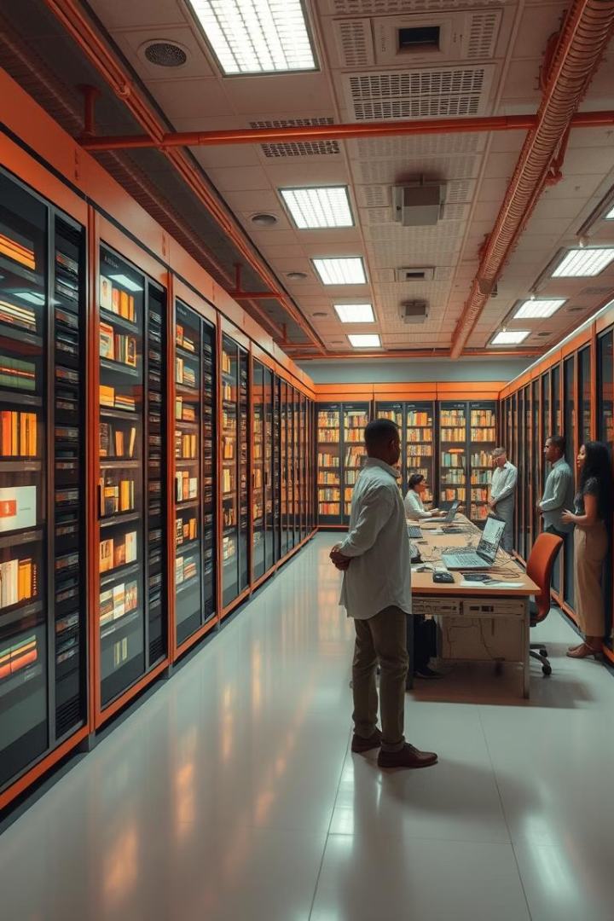
Preserving Multimedia
1
Digitize Heritage
Local heritage
2
Support Creators
African multimedia creators
3
Media Libraries
Repositories
4
Cloud Storage
Data centers

Slide 10
Future of Multimedia
AI
1
Rising role
Empowerment
2
Tool for economic empowerment
Identity
3
Promoting African identity

Slide 11
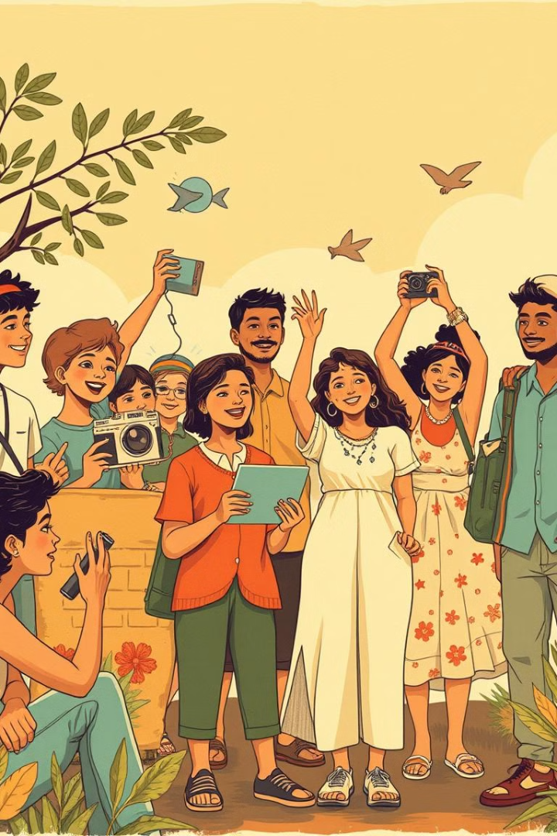
Conclusion
Multimedia shapes modern society.
Responsible use benefits all sectors.
Africa must preserve and invest in multimedia.
Embrace, innovate, and safeguard multimedia for generations.

Slide 12
END.
Thank you!

